Slide 1
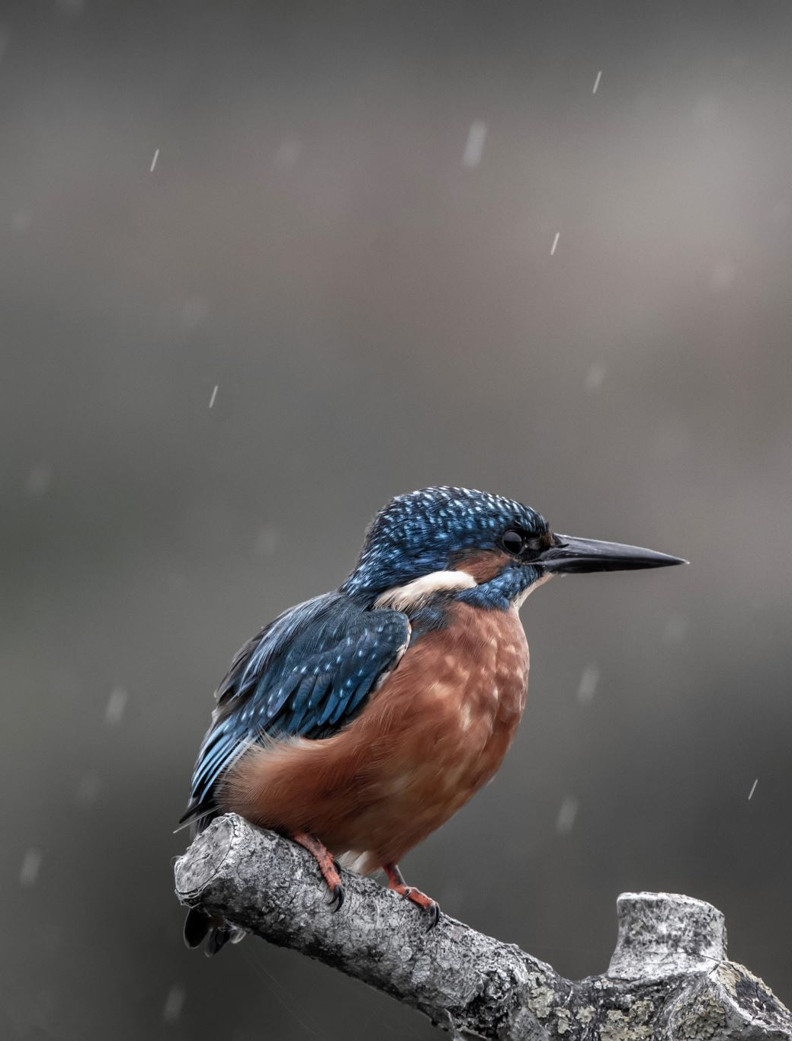
FAA Wildlife Strikes, 2015
BY Mina Botros

Slide 2

- Examine the FAA Wildlife Strikes dataset from 2015 to assess its financial implications. - Generate informative visualizations using Tableau, highlighting crucial data points. - Identify any recurring patterns and trends associated with wildlife strikes. - Develop an interactive dashboard to address inquiries concerning the dataset.
Goals

Slide 3
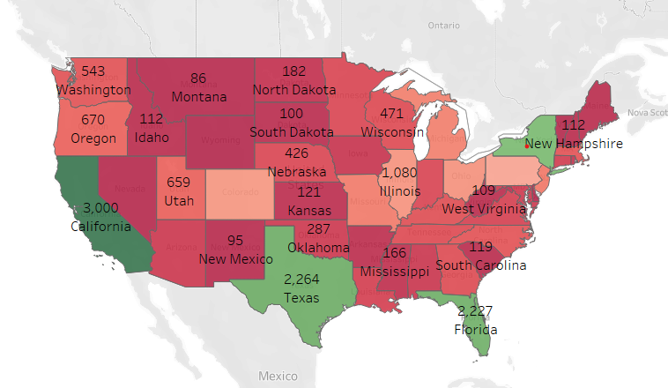
California 3.000 - Texas 2.264 - Florida 2.227 - New York 2.080
Which are the states with higher incidences?

Slide 4
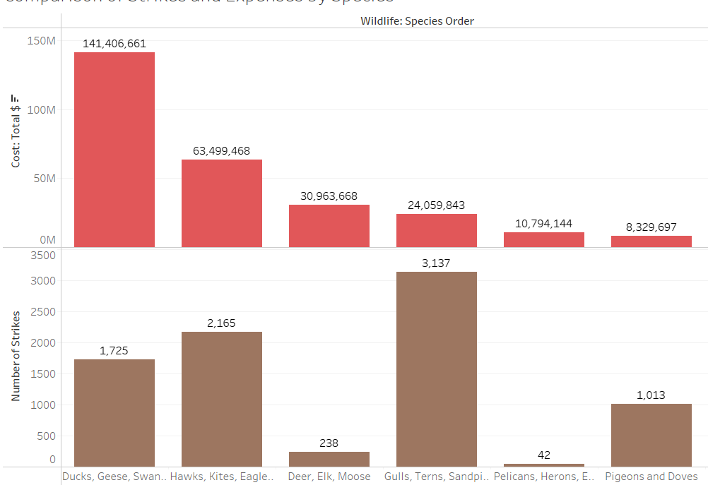
- The highest costs are associated with incidents involving the Geese, Ducks, and Swans species group. - The Gulls, Terns, and Sandpipers species family experiences the highest number of strikes, yet they rank fourth in terms of associated costs.
The animal species with the highest impact and associated expenses.

Slide 5
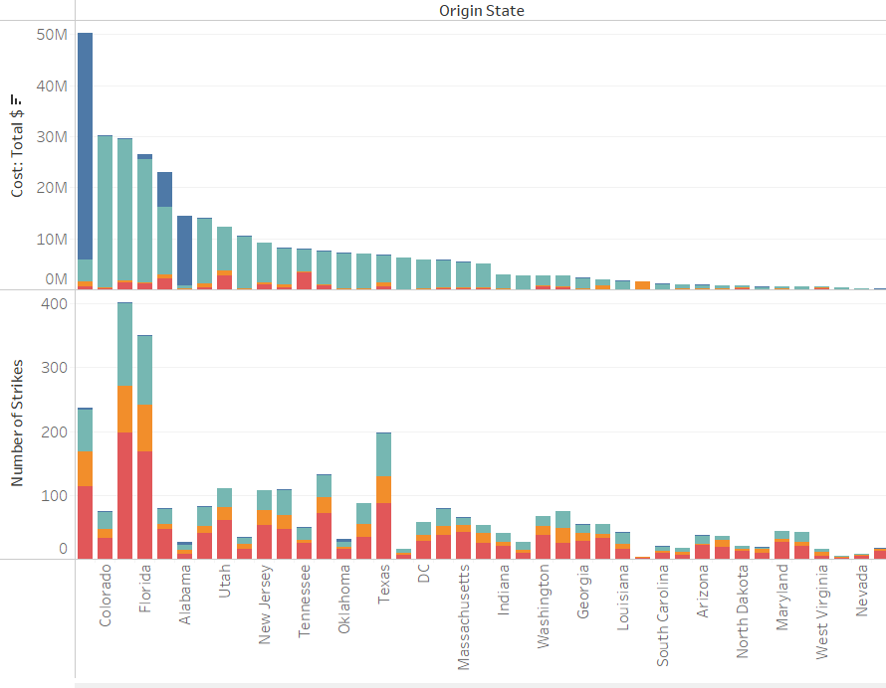
What are the expenses associated with these strikes in each state?
- California has the highest number of incidents, but it ranks third in terms of cost. This discrepancy arises because most cases with substantial costs involve specific types of damage.
- In contrast, New York incurs the highest expenses, primarily due to incidents resulting in aircraft destruction.

Slide 6
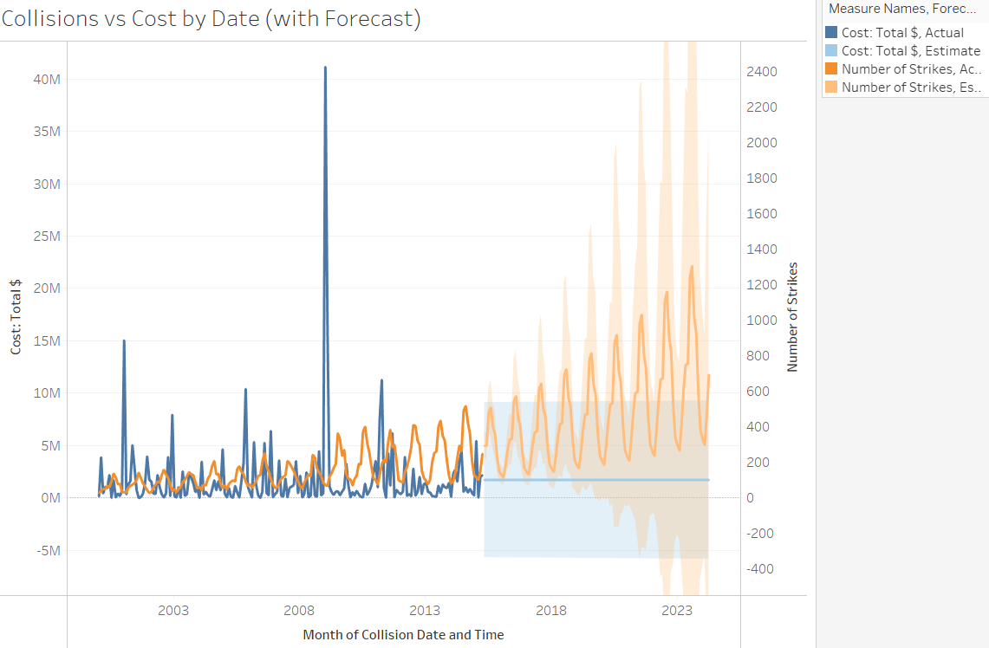
What are the expenses associated with collisions over time and in future predictions?
- There was an extraordinary value in 2001, with more than 15 m. and 2009 with value more than 41 m .
- Most incidents occur around summer in August .
- The projection for the next 9 years is like the actual values.

Slide 7
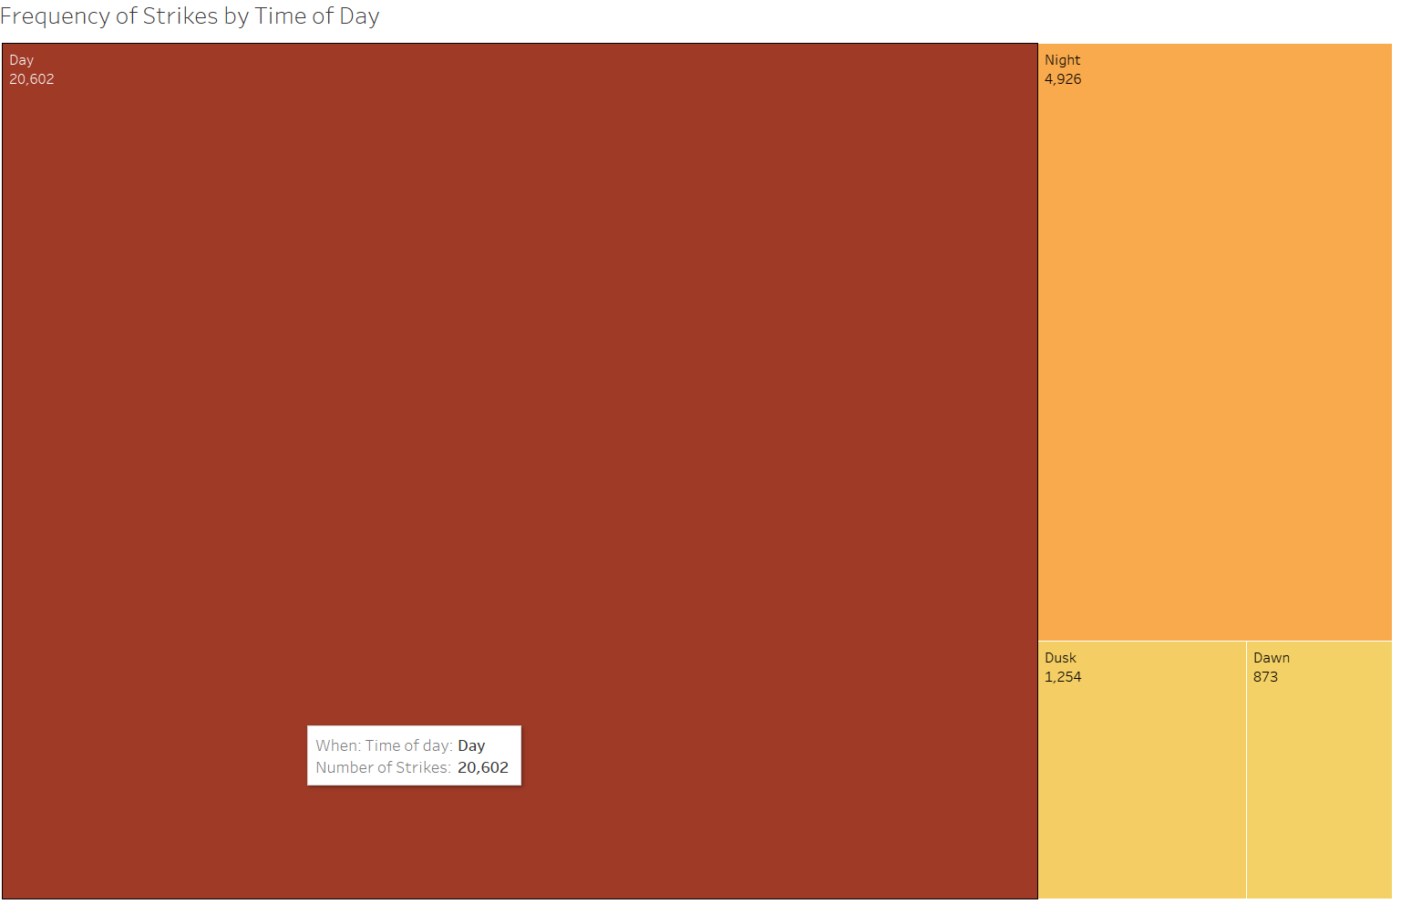
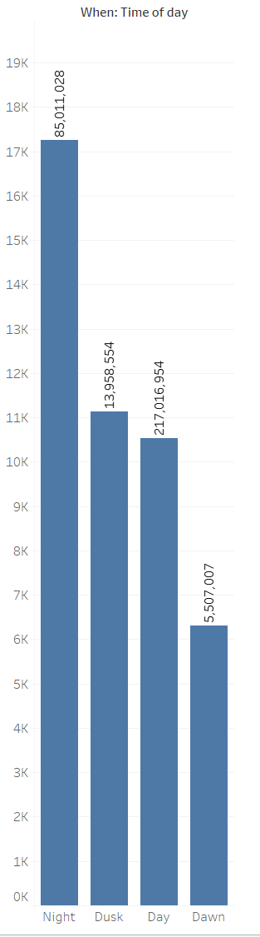
Incident frequency varies at different times of the day.
- Most incidents happened during the day.
- The most expensive on average occurred during the nighttime.

Slide 8
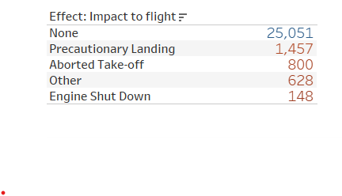
What the Strikes Effect on Flights

Slide 9
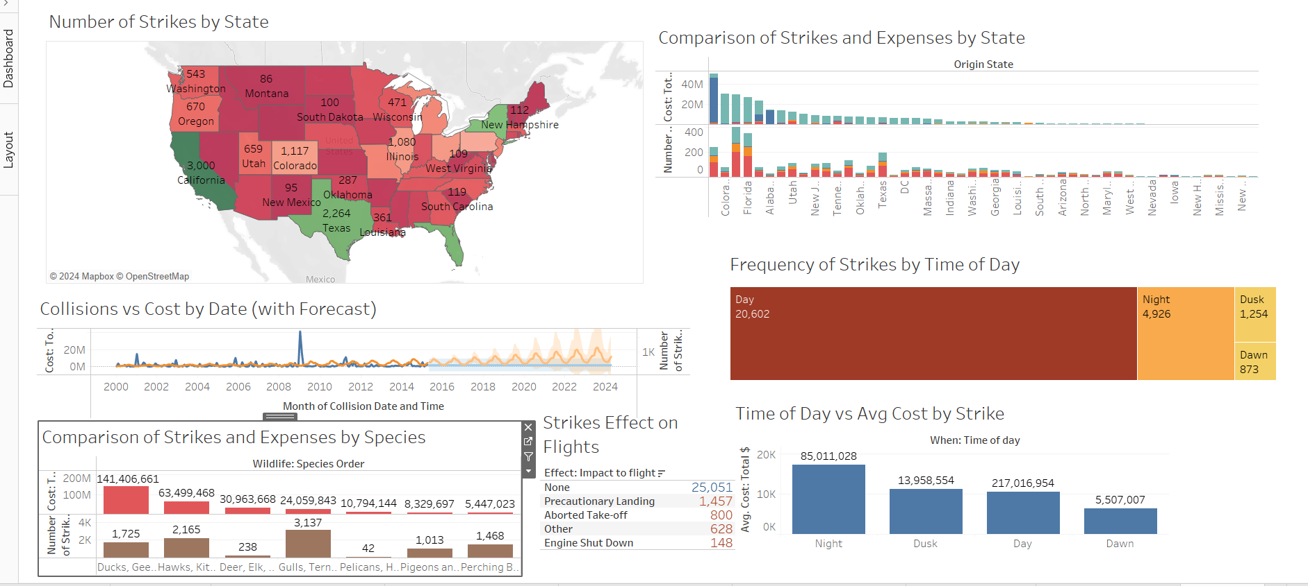
Dashboard

Slide 10

Thank you

